Slide 1




Artificial Intelligence Training
Multi-Tiered AI & Data Management Training Program for Northern Command

Slide 2
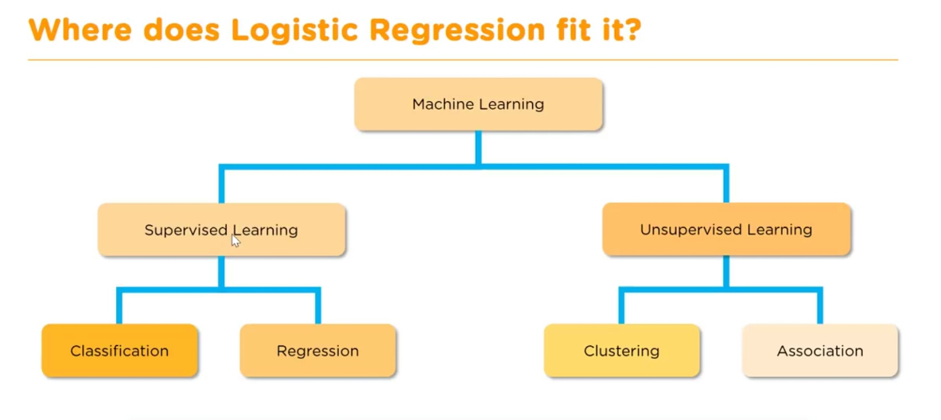

Where logistic regression fits?
Logistic Regression – Supervised Learning
It’s a classification model
01

Slide 3
What is Logistic Regression?
Logistic Regression is a supervised learning algorithm used for classification problems.
Instead of predicting continuous values (like Linear Regression), it predicts probabilities that map to classes (0 or 1).
Example: Predict whether a student passes (1) or fails (0) based on study hours.
02

Slide 4

Equation of Logistic Regression
p(y=1∣x)p(y=1|x)p(y=1∣x): Probability of belonging to class 1
e: Euler’s number (~2.718)
β0​: Intercept
β1​: Coefficient for feature x
03

Slide 5
Why Logistic Regression?
Simple and efficient for binary classification.
Works well when the relationship between features and outcome is approximately linear in the log-odds space.
Probabilistic output (not just class labels) helps in decision making.
Easy to interpret and computationally inexpensive.
04

Slide 6
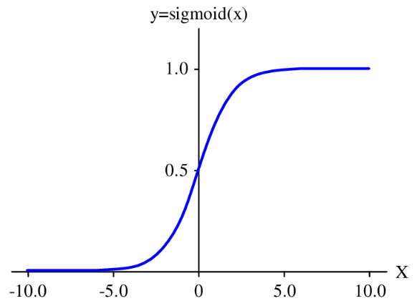
Intuitions of Logistic Regression?
Instead of drawing a straight line like Linear Regression, Logistic Regression uses the Sigmoid Curve.
The sigmoid ensures output always lies between 0 and 1.
Threshold (commonly 0.5):
If probability ≥ 0.5 → Class = 1
If probability < 0.5 → Class = 0
05

Slide 7

The Sigmoid Function
Output always between 0 and 1.
Converts linear values into probabilities.
"S-shaped" curve.
06

Slide 8
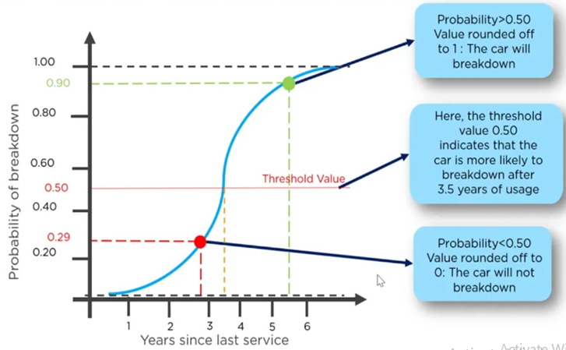
Let’s take some analogy case to understand
Imagine it’s been a few years since you serviced your car
In x-axis – You’re marking years since last service
In y-axis – you’re marking the probability of breakdown
07

Slide 9
Let’s work-out on simple dataset
Hours (X) | Pass (Y)
1 | 0
2 | 0
3 | 0
4 | 0
5 | 1
6 | 1
7 | 1
8 | 1
9 | 1
10 | 1
Linear Function: Compute z=β0+β1⋅X
Apply Sigmoid: Convert z into probability
08

Slide 10

Let’s work-out on simple dataset
Hours (X) | Pass (Y)
1 | 0
2 | 0
3 | 0
4 | 0
5 | 1
6 | 1
7 | 1
8 | 1
9 | 1
10 | 1
Decision Rule:
If p≥0.5p → predict Pass (1)
Else → predict Fail (0)
Training (Learning Parameters):
Use Maximum Likelihood Estimation (MLE) to find best β0,β1
Minimize Log Loss (Binary Cross-Entropy):
09

Slide 11
Hyper parameters in logistic regression
Penalty (regularization):
l1 (Lasso): feature selection
l2 (Ridge): prevent overfitting
C (inverse of regularization strength): Smaller C → stronger regularization
Solver: Algorithm used for optimization (liblinear, saga, newton-cg, etc.)
Max_iter: Maximum number of iterations allowed for convergence.
02

Slide 12
Let’s dock this study with defence scenario
In real missions, different types of operations (skirmish, ambush, full assault) consume ammo in different patterns:
A skirmish → short duration, fewer rounds, small enemy size.
An ambush → medium duration, sudden heavy fire, moderate enemy strength.
A full assault → long duration, large rounds, big enemy size.
So the ML task here is:
Given inputs like ammo type, rounds used, terrain, attack duration, and enemy strength…
Classify what type of mission it most likely was (skirmish, ambush, full assault).
10

Slide 13
What we’re classifying ?
We’re teaching the ML model to recognize which kind of mission a soldier group was engaged in, just by looking at the ammo usage and contextual features.
Target label: mission_class
Classes: skirmish, ambush, full assault
We’re teaching the ML model to recognize which kind of mission a soldier group was engaged in, just by looking at the ammo usage and contextual features.
11

Slide 14
How this model helps with defence group?
Operational insight → Helps officers see how data-driven models can recognize mission patterns from raw usage data.
Planning & logistics → If we can classify past missions accurately, the same model can predict expected mission type during planning and assist in ammo allocation.
Training demo → Shows how to take battlefield-style logs and convert them into a classification problem (a very core ML workflow).
Engagement → The “mission class” resonates with officers more than abstract dataset labels like “Iris flower types.
12

Slide 15
Pros of logistic regression
Simple, fast, and interpretable
Outputs probabilities (useful for risk analysis)
Works well with linearly separable data
Less prone to overfitting if regularized
13

Slide 16
Limitations of logistic regression
Assumes linear relationship in log-odds space
Not suitable for very complex datasets (non-linear boundaries)
Struggles with high-dimensional or highly correlated features
Works poorly if classes are highly imbalanced
14

Slide 17
Hands-on: Ammunition Usage Optimization
Hands-on code to explore logistic regression with ammunition usage dataset
15

Slide 18
Support Vector Machine

Slide 19
What is Logistic Regression?
Used for Classification as well as Regression problems. However, primarily, it is used for Classification problems in Machine Learning.
Goal is to create the best line or decision boundary that can segregate n-dimensional space into classes so that we can easily put the new data point in the correct category in the future. This best decision boundary is called a hyperplane.
SVM chooses the extreme points/vectors that help in creating the hyperplane. These extreme cases are called as support vectors, and hence algorithm is termed as Support Vector Machine.
16

Slide 20
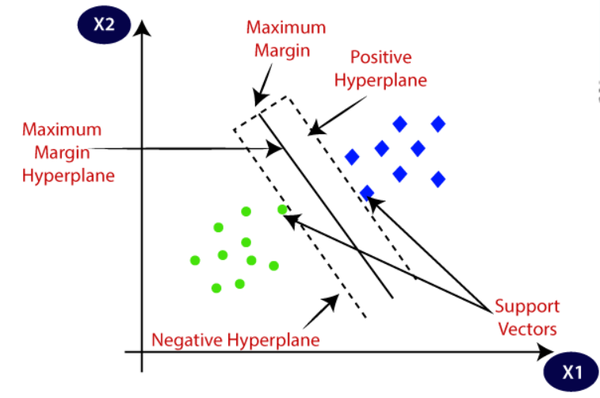
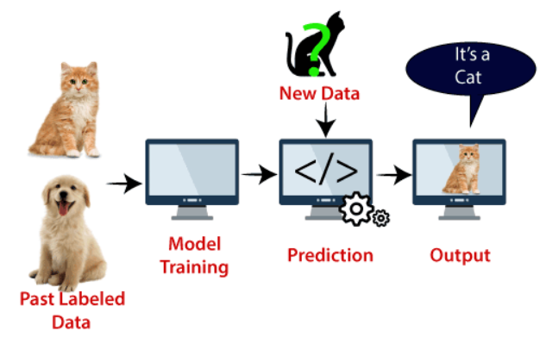
Support Vector Machine
Two different categories that are classified using a decision boundary or hyperplane:
17

Slide 21
Types of Support Vector Machine
Linear SVM: Linear SVM is used for linearly separable data, which means if a dataset can be classified into two classes by using a single straight line, then such data is termed as linearly separable data, and classifier is used called as Linear SVM classifier.
Non-linear SVM: Non-Linear SVM is used for non-linearly separated data, which means if a dataset cannot be classified by using a straight line, then such data is termed as non-linear data and classifier used is called as Non-linear SVM classifier.
18

Slide 22
What is Hyper Plane?
There can be multiple lines/decision boundaries to segregate the classes in n-dimensional space, but we need to find out the best decision boundary that helps to classify the data points. This best boundary is known as the hyperplane of SVM.
The dimensions of the hyperplane depend on the features present in the dataset, which means if there are 2 features (as shown in image), then hyperplane will be a straight line. And if there are 3 features, then hyperplane will be a 2-dimension plane.
We always create a hyperplane that has a maximum margin, which means the maximum distance between the data points.
19

Slide 23
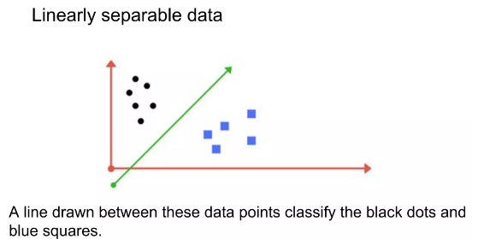
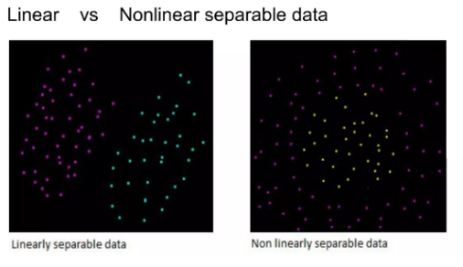
What is support vectors?
The data points or vectors that are the closest to the hyperplane and which affect the position of the hyperplane are termed as Support Vector. Since these vectors support the hyperplane, hence called a Support vector.
20

Slide 24
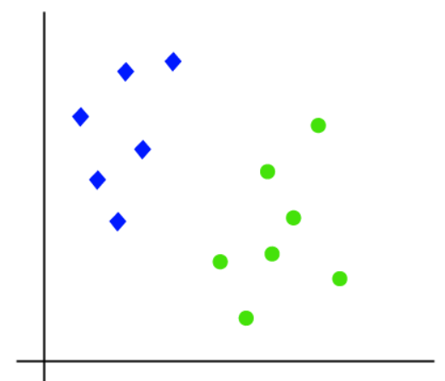
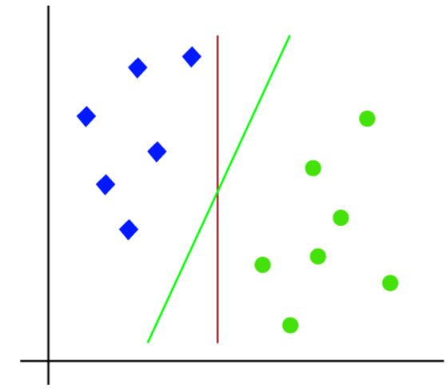
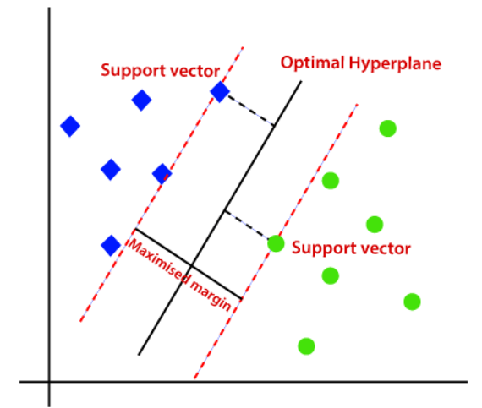
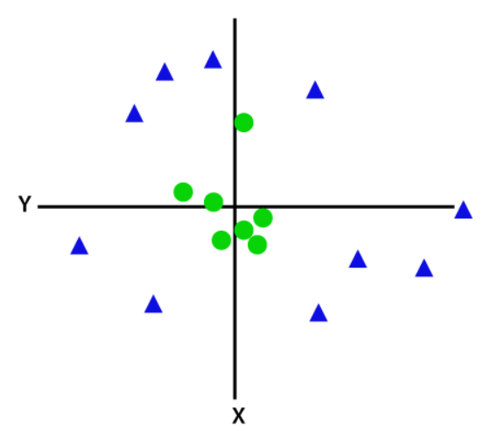
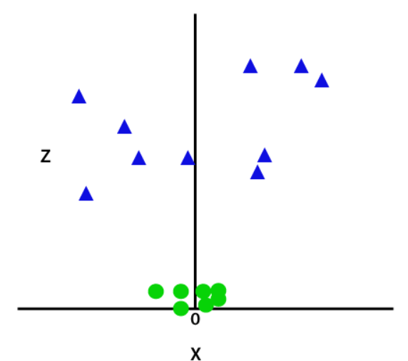
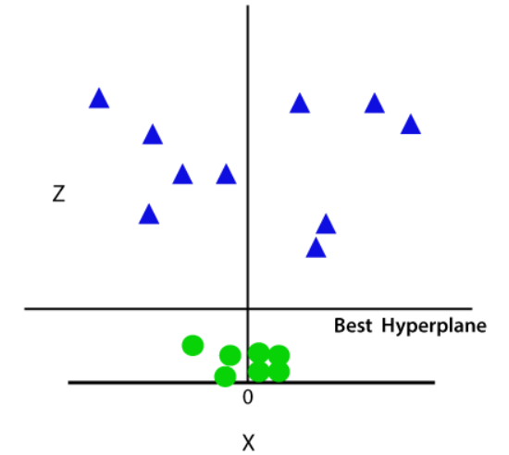
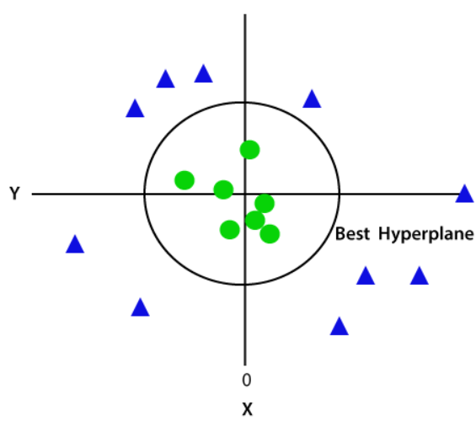
What is Logistic Regression?
Linear SVM:
Non-linear SVM:
21

Slide 25
Fine tuning parameters
Kernel
Regularization
Gamma
Margin
22

Slide 26
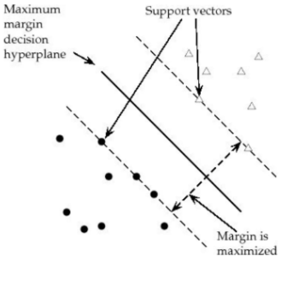
Margin
Margin is the perpendicular distance between the closest data points and the Hyperplane (on both sides) The best optimized line (hyperplane) with maximum margin is termed as Margin Maximal Hyperplane. The closest points where the margin distance is calculated are considered as the support vectors.
23

Slide 27
Regularization
Also the 'C' parameter in Python's SkLearn Library
Optimises SVM classifier to avoid misclassifying the data.
C→ large Margin of hyperplane → small
C→ small Margin of hyperplane → large
misclassification(possible)
1. C--> large, chance of overfit
2. C--> small, chance of underfitting
24

Slide 28
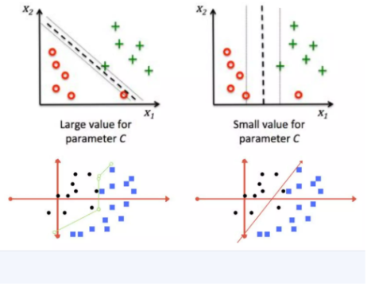
Regularization
25

Slide 29
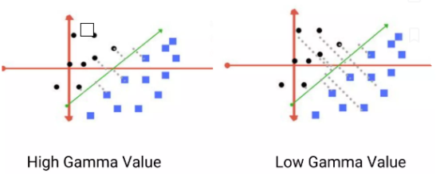
Gamma
Defines how far influences the calculation of of plausible line of separation.
• Low gamma ---> points far from plausible line are considered for calculation
• High gamma -----> points close to plausible line are considered for calculation
26

Slide 30
Kernels
Mathematical functions for transforming data using some linear algebra
Different SVM algorithms use different types of kernel functions
Various kernels available
Linear Kernel
Non-linear Kernel
Radial Basis Function(RBF)
Sigmoid
Polynomial
Exponential
27

Slide 31
Let’s dock this study with defence scenario
We are classifying soldiers into Low/Medium/High cold-injury risk, based on personal & environmental factors, using SVM as the demo ML model.
Imagine soldiers deployed in Kashmir-type high-altitude borders during harsh winters.
Some soldiers develop cold-related injuries (frostbite, hypothermia).
Officers want a predictive model that, given certain risk factors, can classify a soldier’s risk level (Low / Medium / High).
28

Slide 32
What we classify using this model?
The model’s output (target variable = risk_level) is a classification of risk:
Low risk – soldier unlikely to get cold-related injuries
Medium risk – moderate probability
High risk – soldier is very vulnerable and requires preventive action (better gear, less exposure, medical monitoring)
29

Slide 33
Input features used for classification
Age – younger vs older soldiers may differ in resilience
BMI – body fat influences cold resistance
Cold gear quality – good / average / poor (categorical)
Exposure hours – how long soldier is exposed to harsh conditions
Previous injury – if already injured, risk is higher
Snow depth – proxy for how extreme the environment is
30

Slide 34
How this model helps with defence group?
Officers can input soldier details manually in the developed model to observe the results
The ML model instantly classifies the risk level.
They can experiment with parameters (e.g., increasing exposure hours, lowering gear quality) to see how risk changes.
31

Slide 35
Hands-on: Demo
Hands-on code to explore SVM model using causalities winter dataset
32

Slide 36
Thank You

